Slide 1
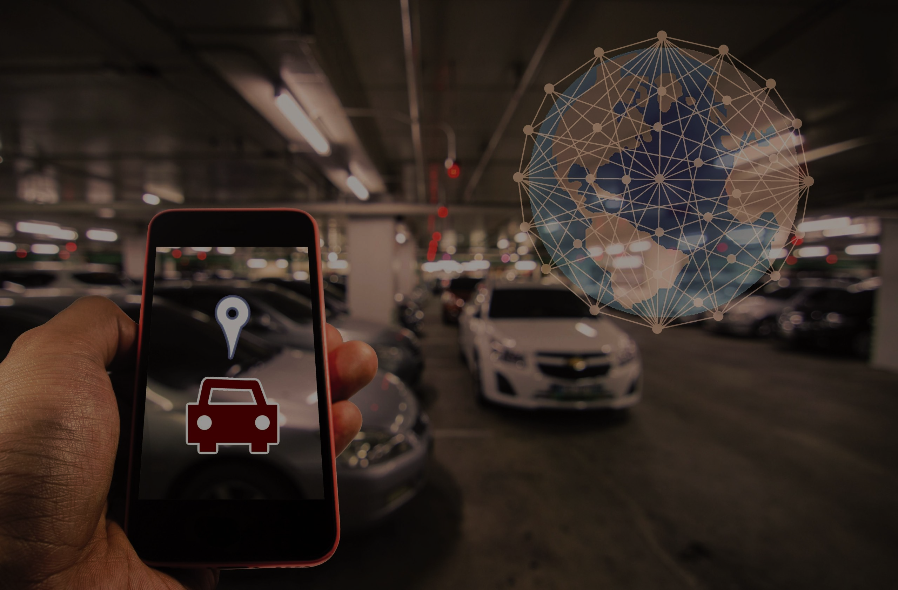

IoT
Smart Parking Assistance

Slide 2
Under the guidance of :
G. Niveditha
Done By :
Atmakuri Nishanth ( 21R11A0558 )
Erramuri Dhanush RajKumar ( 21R11A0567 )
Sapelly Sai Saharsh ( 21R11A0596 )

Slide 3
CONTENTS
Abstract
Existing System
Proposed System
System Configuration

Slide 4
ABSTRACT
The project proposes a Smart Parking System with Availability Detection, leveraging IoT technology to enhance parking efficiency and user experience. Ultrasonic sensors placed strategically in parking areas detect vehicle presence and distance. A central microcontroller processes sensor data in real-time to determine available parking spaces. Indicator lights guide drivers with red for occupied and green for vacant spots. Advanced features could include displaying availability on a smartphone app. The system aims to streamline parking, improve user experience, and potentially reduce traffic congestion.

Slide 5
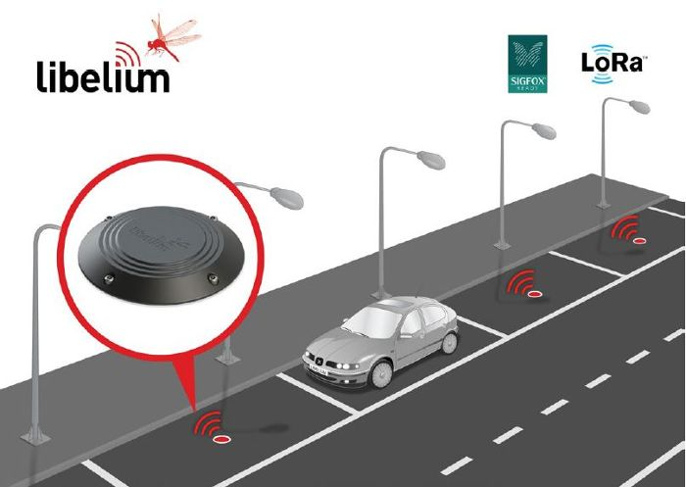
Existing System
The existing system works based on the radar which are installed within the ground with a gap left to detect the presence of the vehicle present in the parking lot.
This method fails in the transmission of real time data to any user with the help of an application.
Radar parking systems struggle with details, have weather misconceptions, and miss low objects. They're expensive and some find them privacy intrusive.

Slide 6
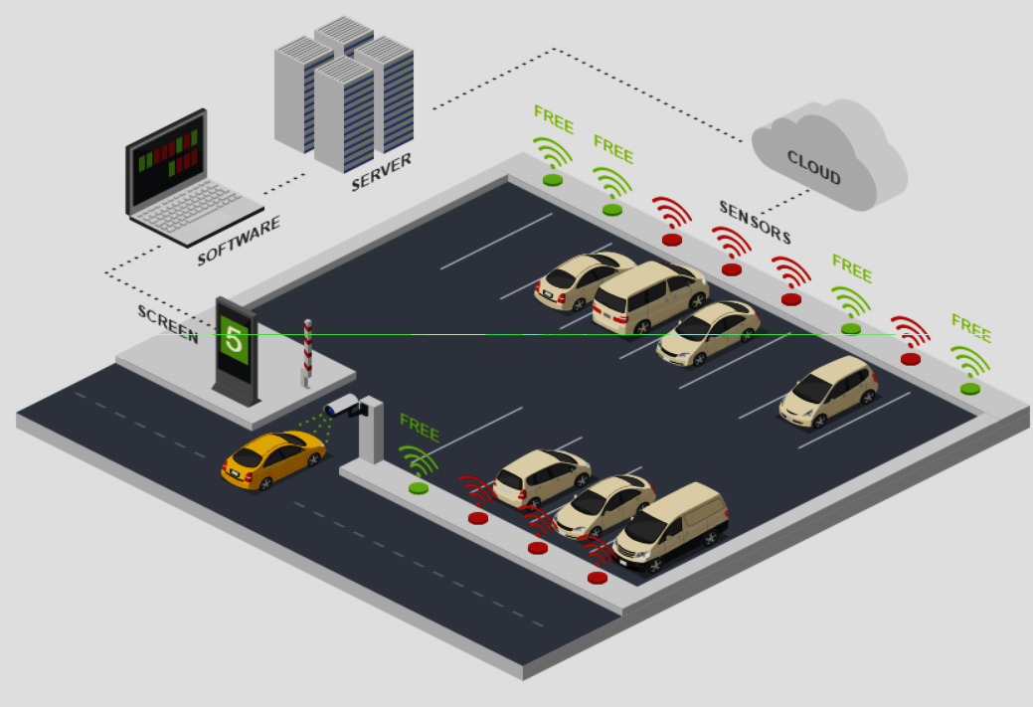
Proposed System
The proposed system works based on the latest IoT technology where sensors are installed within the walls in the parking lot.
This method can be used in the real time transmission of the data regarding the available parking spaces in a parking lot even when the user is on move with the help of a central hub which transmits the data to the user’s device.
This makes it easy for the user to choose a place to park his vehicle.
This works with the help of various sensors and the central focus is not on a single device as of the existing system.

Slide 7
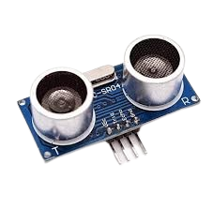
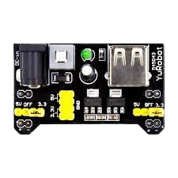
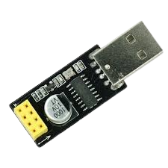
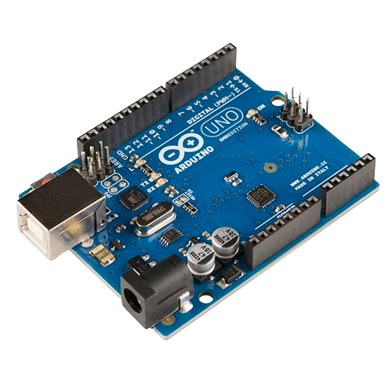
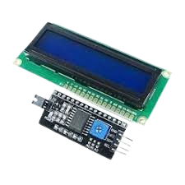
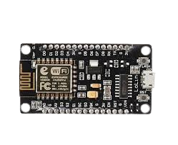
System Configuration
Hardware Requirements :
Power Supply Module
ESP8266 Programmer module
Ultrasonic Sensors
Arduino Uno
LCD display with I2C module
ESP8266

Slide 8



System Configuration
Software Requirements :
Windows OS
Arduino Compiler
Cloud Services

Slide 9
THANK YOU

